Slide 1
Hypothesis Testing
NRES 776
Instructor: Heather Bryan
Sept 28, 2021

Slide 2
Learning Objectives
Practice the process of statistical hypothesis testing
Explain the concepts of p-value, type I and type II error, and power
Describe the difference between statistical significance and biological importance

Slide 3
What is hypothesis testing?
Does the parameter differ from a null expectation?
Is there an effect?
Are two groups different?

Slide 4
What is hypothesis testing?
Does the parameter differ from a null expectation?
Is there an effect?
Are two groups different?
Definition: compare data to what we would expect if a specific null hypothesis (H₀) were true. If data are unusual compared to expected, then H₀ is rejected

Slide 5
Null and Alternative Hypotheses
Null | Alternative
Default | Every other possibility

Slide 6
Null and Alternative Hypotheses
Null | Alternative
Default | Every other possibility
Skeptical point of view (no effect, no difference) | More interesting point of view (there is an effect or difference)

Slide 7
Null and Alternative Hypotheses
Null | Alternative
Default | Every other possibility
Skeptical point of view (no effect, no difference) | More interesting point of view (there is an effect or difference)
Interesting to reject | What researcher hopes is true

Slide 8
Null and Alternative Hypotheses
Null | Alternative
Default | Every other possibility
Skeptical point of view (no effect, no difference) | More interesting point of view (there is an effect or difference)
Interesting to reject | What researcher hopes is true
Specific | Not specific
E.g., The density of dolphins is the same in areas with and without drift-net fishing | E.g., The density of dolphins differs between areas with and without drift-net fishing

Slide 9
Rejecting or Not Rejecting H₀
H₀ is the only statement being tested with data

Slide 10
Rejecting or Not Rejecting H₀
H₀ is the only statement being tested with data
Can either reject or fail to reject H₀

Slide 11
Rejecting or Not Rejecting H₀
H₀ is the only statement being tested with data
Can either reject or fail to reject H₀
Rejection/not rejection is not categorical
There is a continuum from weak to strong evidence for rejection (p-value)

Slide 12
Hypothesis Testing Example
State the hypothesis
Compute the test statistic with the data
Determine the p-value
Draw appropriate conclusions

Slide 13

Hypothesis Testing Example
State the hypothesis
Compute the test statistic with the data
Determine the p-value
Draw appropriate conclusions
What is the proportion of right-handed toads in the population?

Slide 14
Hypothesis Testing Example
H₀ : Left- and right-handed toads are equally frequent in the population (p=0.5)
H₁: Left and right-handed toads are not equally frequent in the population (p!=0.5)

Slide 15
Hypothesis Testing Example
Test statistic: number calculated from the data used to evaluate how compatible the data are with the result expected under the null hypothesis

Slide 16
Hypothesis Testing Example
Test statistic: number calculated from the data used to evaluate how compatible the data are with the result expected under the null hypothesis
14/18 toads right-handed
9/18 toads expected to be right-handed

Slide 17
Hypothesis Testing Example
Test statistic: number calculated from the data used to evaluate how compatible the data are with the result expected under the null hypothesis
14/18 toads right-handed
9/18 toads expected to be right-handed
What is the probability of getting a sample with 14/18 toads if H₀ is true?

Slide 18
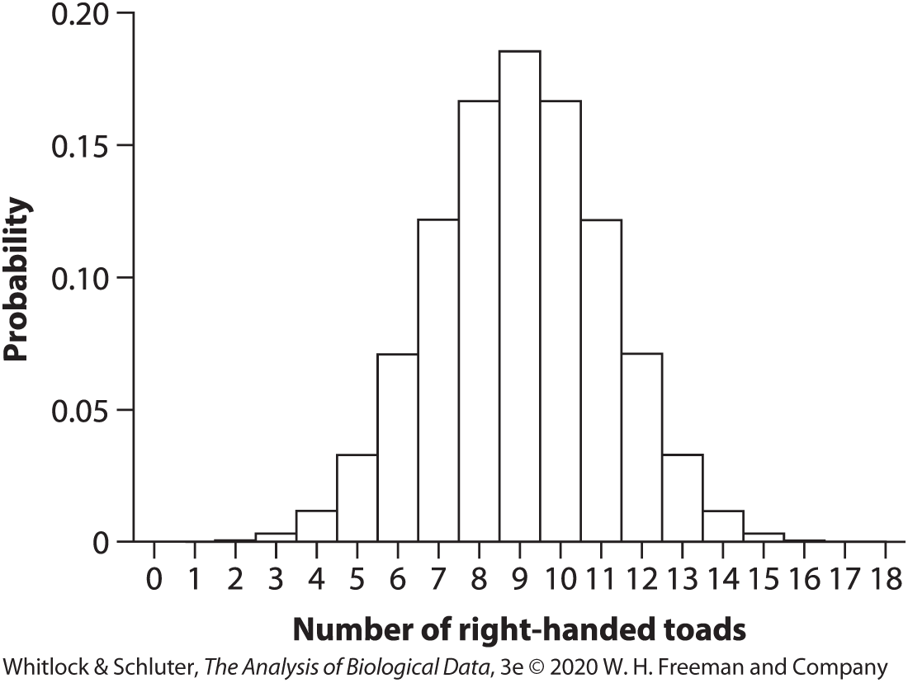
Hypothesis Testing Example
Null Distribution: sampling distribution of outcomes for a test statistic

Slide 19
Hypothesis Testing Example
Null Distribution: sampling distribution of outcomes for a test statistic
# R-handed toads | P
0 | 0.000004
1 | 0.00007
2 | 0.0006
3 | 0.0031
4 | 0.0117
5 | 0.0327
6 | 0.0708
7 | 0.1214
8 | 0.1669
9 | 0.1855
10 | 0.1669
11 | 0.1214
12 | 0.0708
13 | 0.0327
14 | 0.0117
15 | 0.0031
16 | 0.0006
17 | 0.00007
18 | 0.000004
Total | 1.0

Slide 20
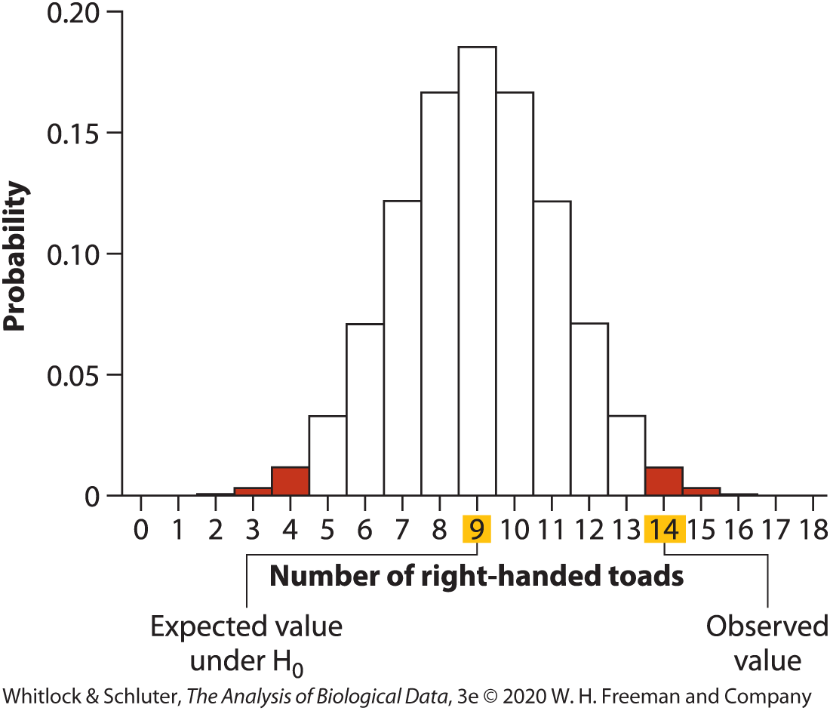
Hypothesis Testing Example
P-value: probability of obtaining the data (or data showing as great or greater difference from null hypothesis) if the null hypothesis were true

Slide 21
Hypothesis Testing Example
# R-handed toads | P
0 | 0.000004
1 | 0.00007
2 | 0.0006
3 | 0.0031
4 | 0.0117
5 | 0.0327
6 | 0.0708
7 | 0.1214
8 | 0.1669
9 | 0.1855
10 | 0.1669
11 | 0.1214
12 | 0.0708
13 | 0.0327
14 | 0.0117
15 | 0.0031
16 | 0.0006
17 | 0.00007
18 | 0.000004
Total | 1.0
P = 0.0115 * 2 = 0.031

Slide 22
Hypothesis Testing Example
P = 0.0115 * 2 = 0.031

Slide 23

Hypothesis Testing Example
P = 0.0115 * 2 = 0.031
Reject the null at $∝$ = 0.05

Slide 24

Hypothesis Testing Example
P = 0.0115 * 2 = 0.031
Reject the null at $∝$ = 0.05
Reporting the results:
value of the test statistic (14)
sample size (18)
P-value (0.031)
Confidence Interval (0.54<p<0.91)
Biological Interpretation: The proportion of right-handed toads in the sample was higher than expected due to chance alone.

Slide 25

Errors in hypothesis testing
Type I error: probability of rejecting H₀ when it is true (set using $∝$ )
Type II error: probability of retaining (failing to reject) H₀ when it is false ($β)$

Slide 26

Errors in hypothesis testing
Type I error: probability of rejecting H₀ when it is true (set using $∝$ )
Type II error: probability of retaining (failing to reject) H₀ when it is false ($β)$
Conclusion | Reality: H₀ true | Reality: H₀ false
Reject H₀ | Type I error ($∝$) | Correct (1-$β)$
Do not reject H₀ | Correct (1-$∝$) | Type II error ($β)$

Slide 27

Power of a test
Low probability of Type II error = high power (1-$β)$
Power: probability that a random sample will lead to rejection of a null hypothesis when it is false
More power if sample size is large, effect size is large, and variability low

Slide 28
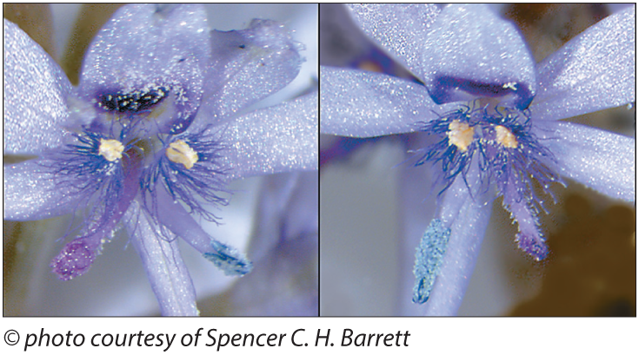
What does ‘not significant’ mean?
Notes:
Mud-plantain is a plant with both male and female organs
To avoid inbreeding caused by self-fertilization, the style deflects to the left in some individuals and right in others and the anther deflects to the opposite side
Bees that collect pollen from flowers with left-handed styles collect pollen on their right hand sides and then deposit that pollen to right-handed styles
Researchers wanted to know whether these traits are passed down via a simple genetic model so they did a cross-breeding experiment

Slide 29
What does ‘not significant’ mean?
Cross-breeding experiment that yielded 27 offspring, with 6 left-handed and 21 right-handed
H₀ (Simple genetic model): proportion of left-handed plants in the offspring is ¼
H₁: p!=1/4
Notes:
Mud-plantain is a plant with both male and female organs
To avoid inbreeding caused by self-fertilization, the style deflects to the left in some individuals and right in others and the anther deflects to the opposite side
Bees that collect pollen from flowers with left-handed styles collect pollen on their right hand sides and then deposit that pollen to right-handed styles
Researchers wanted to know whether these traits are passed down via a simple genetic model so they did a cross-breeding experiment

Slide 30
What does ‘not significant’ mean?
Observed number left-handed flowers: 6
Expected number left-handed flowers: 6.75 (1/4 of 27)

Slide 31
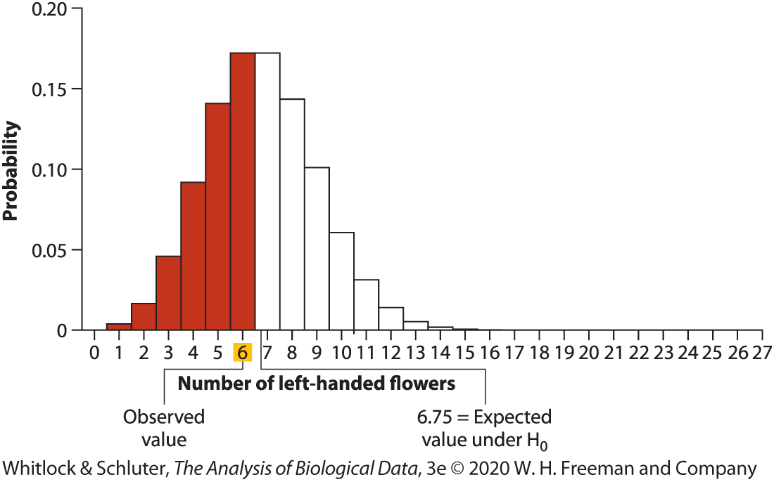
What does ‘not significant’ mean?
Observed number left-handed flowers: 6
Expected number left-handed flowers: 6.75 (1/4 of 27)

Slide 32
What does ‘not significant’ mean?
Observed number left-handed flowers: 6
Expected number left-handed flowers: 6.75 (1/4 of 27)
P = 0.942
Fail to Reject H0

Slide 33
What does ‘not significant’ mean?
Observed number left-handed flowers: 6
Expected number left-handed flowers: 6.75 (1/4 of 27)
P = 0.942
Fail to Reject H0
95% CI
0.10<p<0.41

Slide 34
What does ‘not significant’ mean?
Two proportions are the same or that the two proportions are different but data are too sparse to demonstrate a difference

Slide 35
What does ‘not significant’ mean?
Two proportions are the same or that the two proportions are different but data are too sparse to demonstrate a difference
Failing to reject H₀ is not the same as accepting H₀

Slide 36
What does ‘not significant’ mean?
Two proportions are the same or that the two proportions are different but data are too sparse to demonstrate a difference
Failing to reject H₀ is not the same as accepting H₀
*Can gain evidence for a hypothesis, but not possible to prove a hypothesis

Slide 37
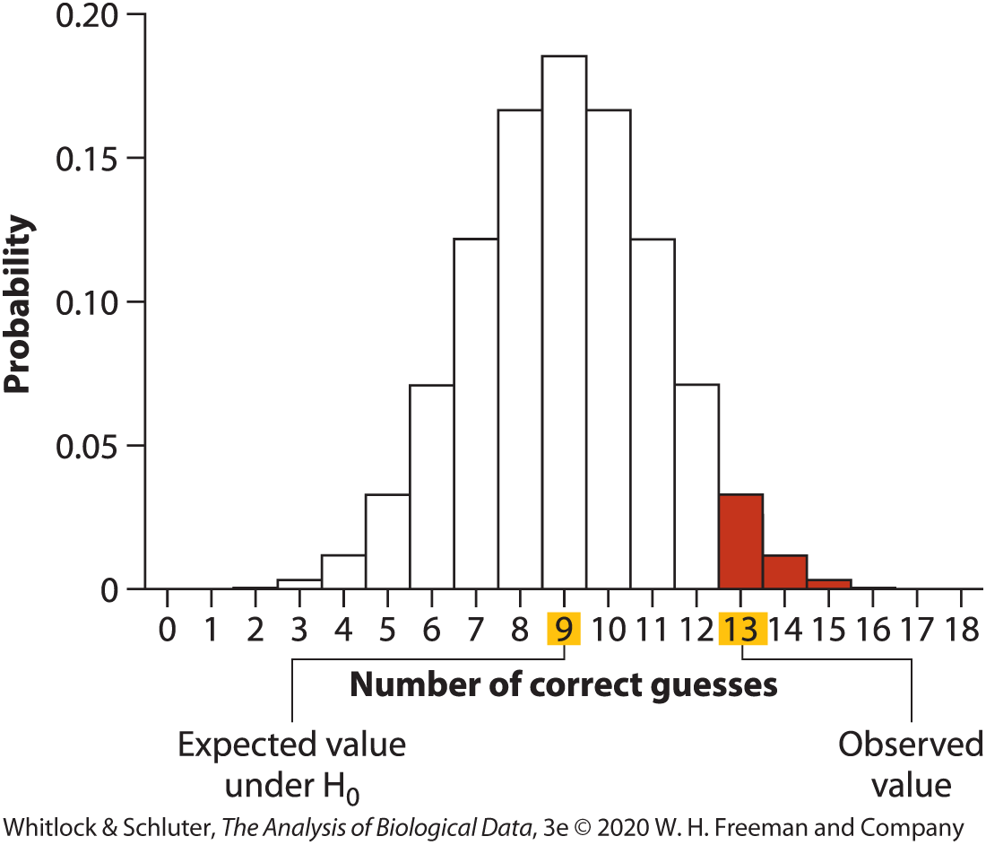
One-sided tests
H1 includes parameter values on only one side of the value specified by H0
Sometimes justifiable if values above or below the value specified by H0 do not make sense or there is considerable information known about your prediction
E.g., Predicting father-daughter relationships based on resemblance in photographs
H0: Participants pick the father correctly 50% of time (p = 0.5)
H1: Participants pick the father correctly more than 50% of time

Slide 38
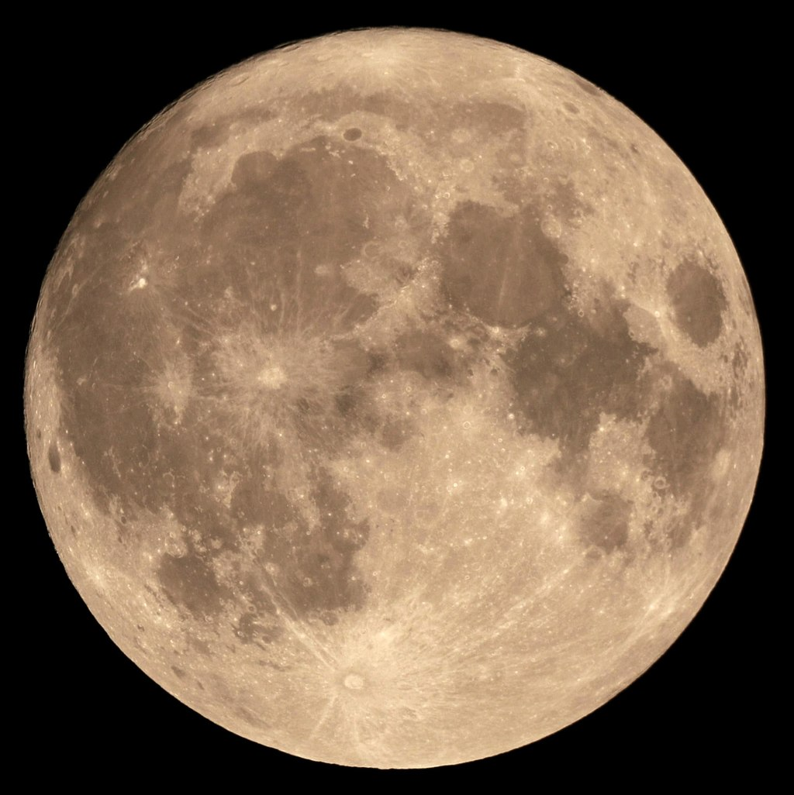
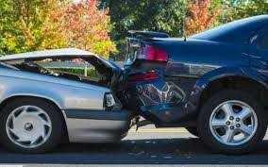
Statistical significance is not the same as biological importance
Results can be statistically significant but not important (e.g., small effect size, such as 1% increase in car accidents during full moon)
Notes:
Car image: https://getblogo.com/what-to-do-after-a-car-accident/
Moon: Tom Ruen Wikipedia.org

Slide 39
Statistical significance is not the same as biological importance
Results can be biologically important but not statistically significant (e.g., initial drug trial on a small sample population)
Take home message: don’t rely exclusively on p-values! Need to also think about magnitude of the effect and whether there is a plausible mechanism to explain differences

Slide 40
True or False?
If a 95% confidence interval for the mean is calculated from a random sample as 0.9 ≤ μ ≤ 3.1, then we say that there’s a 95% chance that the mean lies between 0.9 and 3.1.
The probability that an individual is blinking when a photograph is taken is about 0.04. This means that if a photo of 2 people is taken, the probability that at least one is blinking is 0.04 + 0.04 = 0.08.
The P-value from a test of treatment effects in a clinical trial was calculated as 0.12. The null hypothesis of no treatment effect was not rejected (P > 0.05). We can conclude that the treatment is ineffective.
The P-value from a test of treatment effects in a clinical trial was calculated as 0.12. The null hypothesis of no treatment effect was not rejected (P > 0.05). We can conclude that the treatment effect (the difference between treatment means) is small.
The P-value from a test of treatment effects in a clinical trial was calculated as 0.001. The null hypothesis of no treatment effect was soundly rejected. We can conclude that the treatment effect (the difference between treatment means) is large.
(Questions from Schluter 2020 https://www.zoology.ubc.ca/~bio501/R/lecturepdf/01.introduction.pdf)

Slide 41
Answers
False
False
False
False
False

